Slide 1
PHYLUM ARTHROPODA
BY
DR. OKOH H.I.

Slide 2
PREAMBLE
All organisms in this world are either
- Plants
Animals
In – between e.g. Euglena

Slide 3
The Kindgom Animalia is further divided into
Phylum Protozoa
Phylum Coelenterata
Phylum Porifera
Phylum Platyhelminthes
Phylum Nematoda
Phylum Annelida
Phylum Echinodermata
Phylum Mollusca
Phylum Chordata
Phylum Arthropoda

Slide 4
What are arthropods?
Unpleasant creatures: crabs, spiders, beetles,
caterpillars
Fliers: mosquitoes, moth, bees, and wasp
Biters and stingers; bees, wasps, ants, termites,
scorpions
Jumpers: fleas, crickets, grasshoppers
Singers: crickets, cicadas…
A sign of good luck: June beetle
Sign of evil eyes: black beetle
Source of food; larvae, ants, grasshoppers, etc
Medical agents: bees, beetles, scorpions, spiders

Slide 5
ARTHROPODS
“Arthro” means jointed
“Poda” means legs
They are invertebrates characterised by
- multiple jointed appendages
- Exoskeleton made of chitin
Symmetrical body sub – divided into segments
Open Circulatory system
Body cavity between the alimentary canal and body wall
Ventral ladder type of nervous system called ganglia which are situated at different locations in the body with a ladder type linkage
Growth by molting, which is controlled by hormones

Slide 6
Phylum Arthropoda Contd.
Arthropods are the most diverse group of animals on earth
The phylum is the largest in the animal kingdom and the most successful both in diversity and number of species
About 80% of all known animal species belong to this Phylum
Recent estimates puts the total number of species in the phylum at about 6 million
The major reason for their success is
Ability to evolve rapidly by short life cycles
Ability to adapt to new and empty ecological niches

Slide 7
Phylum Arthropoda Contd.
Arthropods are responsible for
Food spoilage
Transmission of infectious organisms
Destruction to building structures and furniture
Cause toxic reactions in vertebrates including man by bites, stings and defensive secretions
They are found in extremes of temperature, toxicity, acidity, and salinity
They are also found in a great variety of habitats than any other animal group including mountain tops, great depths in the ocean, and the icy antarctica

Slide 8
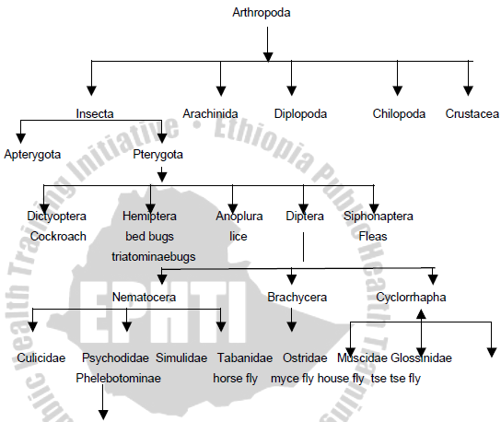
CLASSIFICATION OF THE PHYLUM ARTHROPODA

Slide 9
Classification of Arthropods
Class Insecta/ Hexapoda- (the six legers) The insects.
Class Chilopoda - The centipedes (they have one pair of legs per segment)
Class Diplopoda - The millipedes (they have two pairs of legs per segment)
Class Crustacea - Cyclops, the sea- food group such as lobsters, crabs, cry fish, etc
Class Arachnida - (the eight legers) - Spiders, mites, ticks, scorpions etc.

Slide 10
Class Insecta (Haxapods)
BASIC CHARACTERISTICS:
Six legs
Body structure divided into three parts: Well defined head, thorax and abdomen,
a pair of antennae,
Development: Posses exoskeleton of chitin, growth occurs periodically at ecdyses or moults when exoskeletons are discharged
Life cycle:
(1) Holometabolous life cycle (complete metamorphosis): The larva that hatches out of the egg does not look like the adult e.g. mosquito
(2). Hemimetabolous life cycle (incomplete metamorphosis): In this type of life cycle, the larvae which hatches from the egg resemble the adults, though may look smaller e.g. Grasshopper

Slide 11
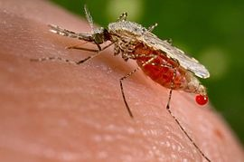
“Mrs” Anopheles Mosquito

Slide 12
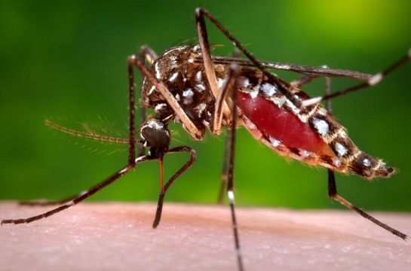
“Mrs” Aedes Mosquito

Slide 13
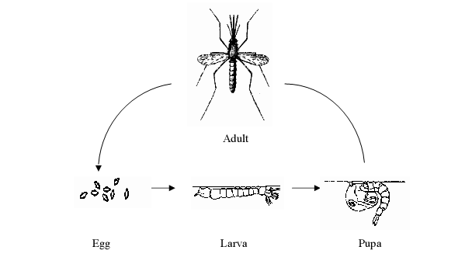
Life Cycle of Mosquito

Slide 14
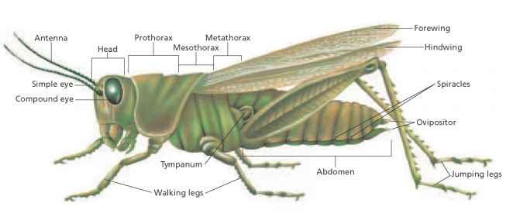
EXTERNAL FEATURES OF GRASSHOPPERS

Slide 15
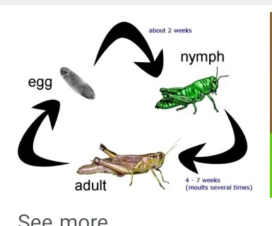
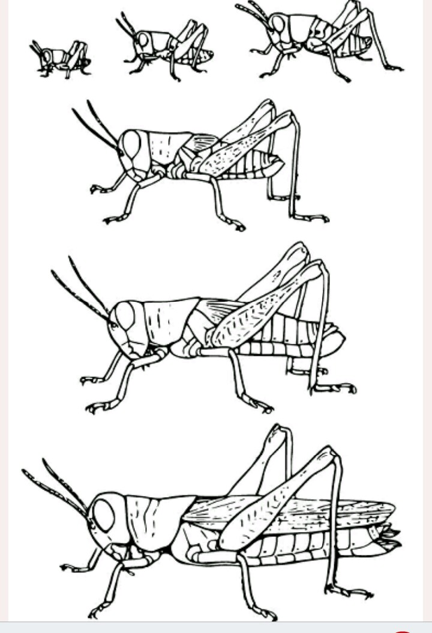
Life cycle of Grass hopper

